Slide 1

Health Care App
GROUP NUMBER : UEE_RSE_19_WE_16
IT16178700 D.I.K. Rajapakshe
IT17018760 M.P.P. Shamil
IT17056212 P.M.c.p. paththinisekara
IT17152938 S.K. Liyanage

Slide 2
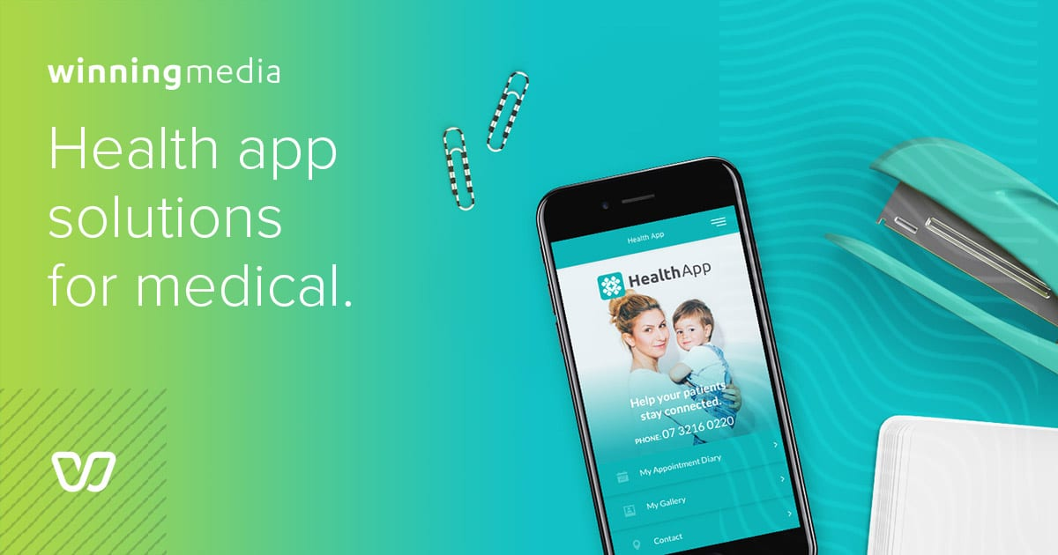
IT16178700
PROFILE FUNCTION

Slide 3
IT16178700
Main Functions
Create Profile.
Sign in Application.
View Login Details.
Settings application.
Navigation APp

Slide 4
Superior UI/UX Design
IT16178700
Interfaces with attractive and user friendly colors.
Attractive overall design.
Fast navigation.
Easy to understand and use application
More accurate field validations.

Slide 5
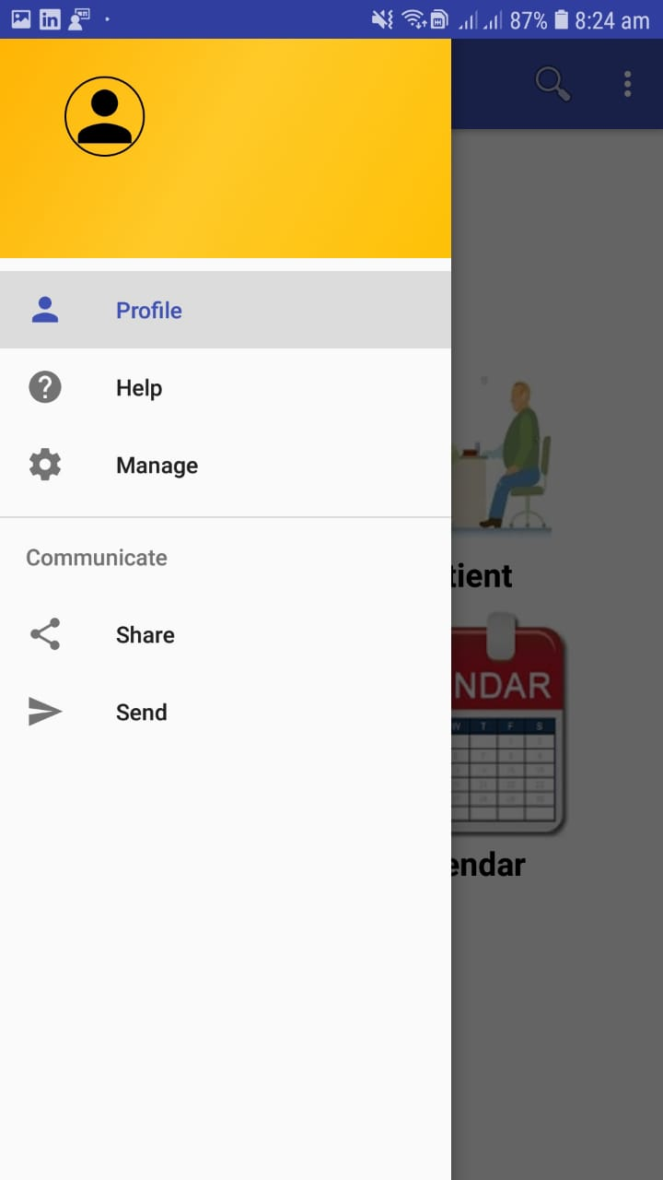
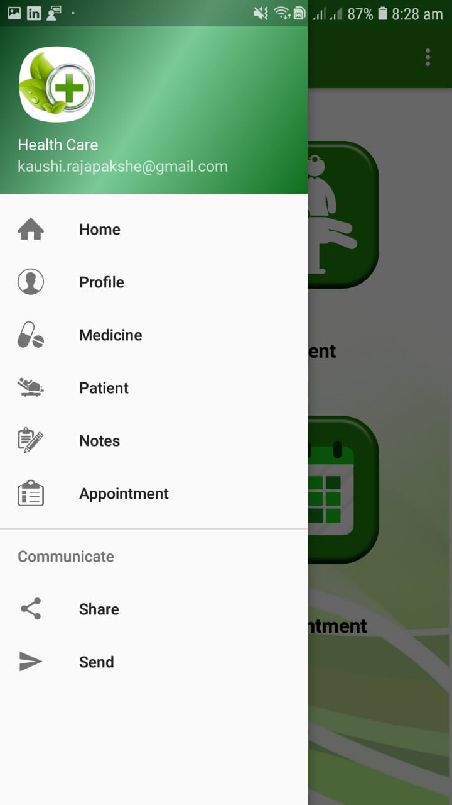
Comparison to other app
IT16178700
Easily usable search field.
More details on the list.
Workable navigation .

Slide 6
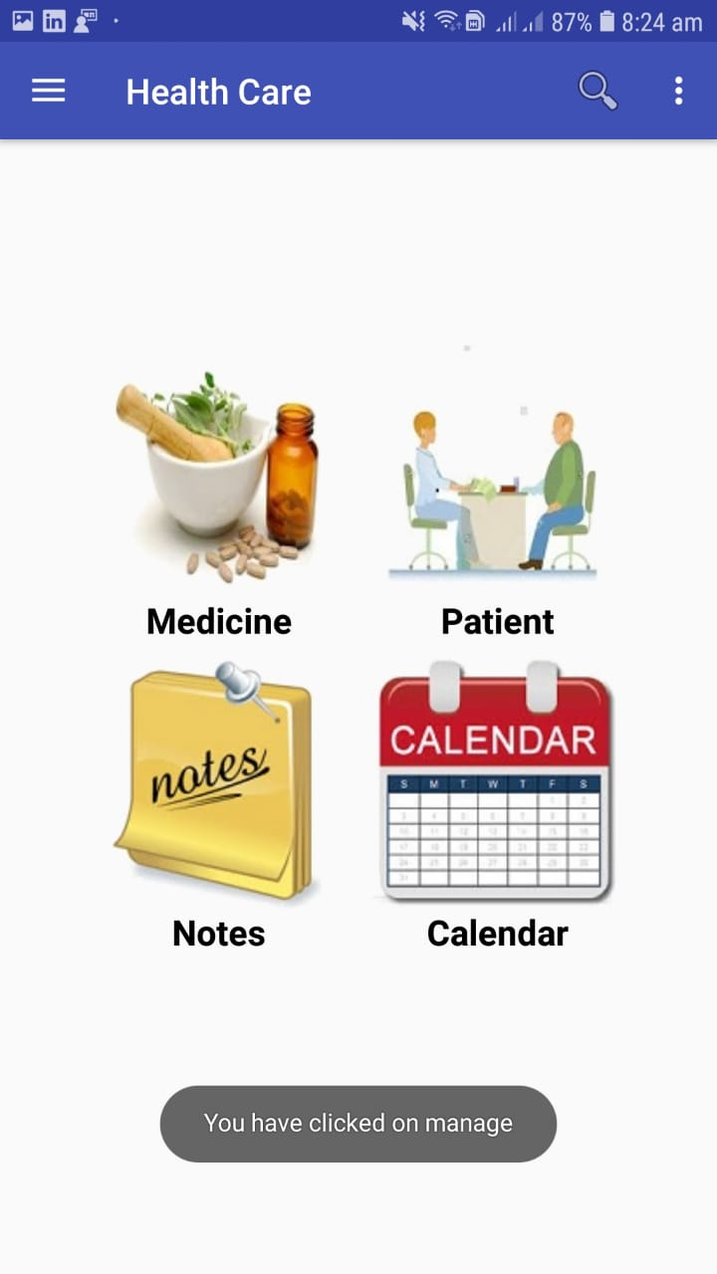
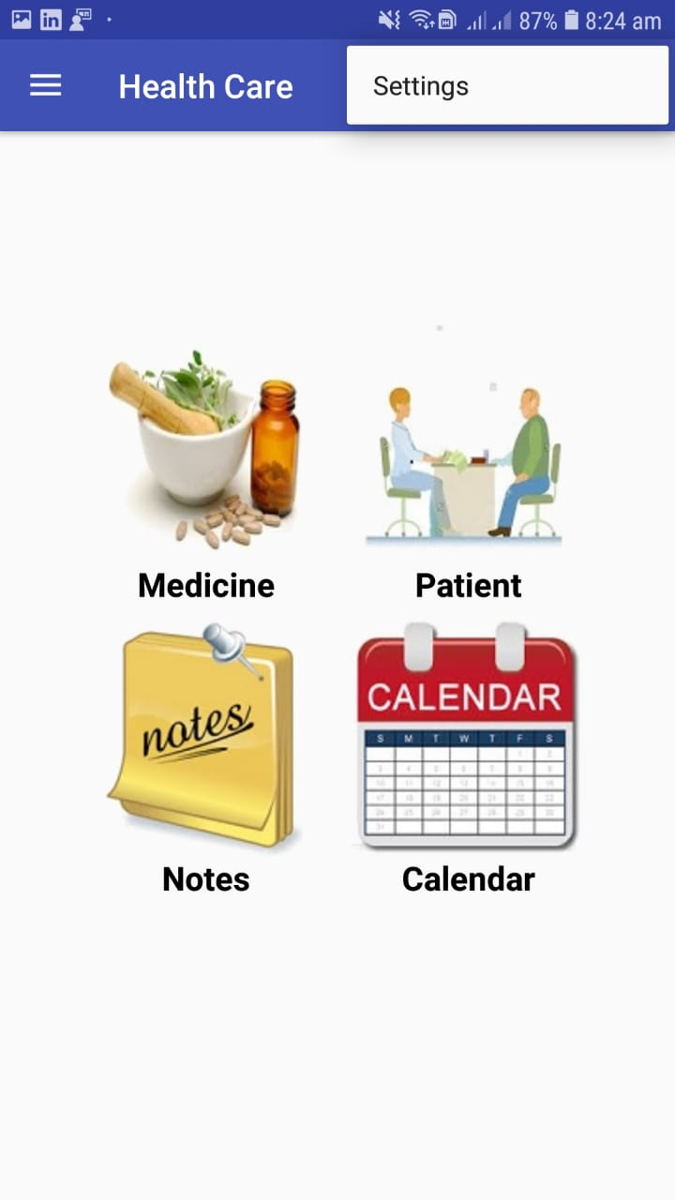
Previous app Failures
IT16178700
After the clicking navigation only display toast message
Not working Settings.

Slide 7
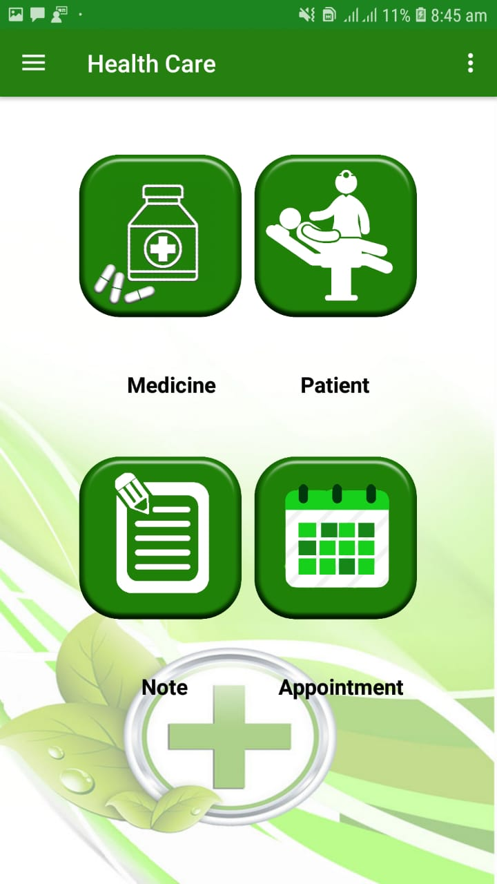
Comparison cont.
IT16178700
Easily recognizable icons.
User friendly colors.

Slide 8
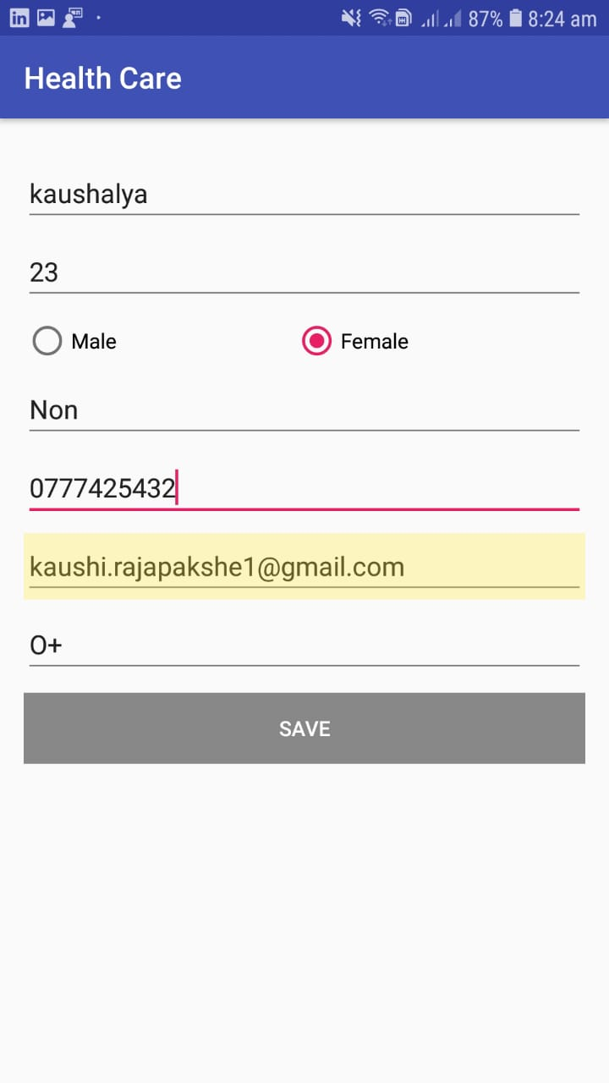
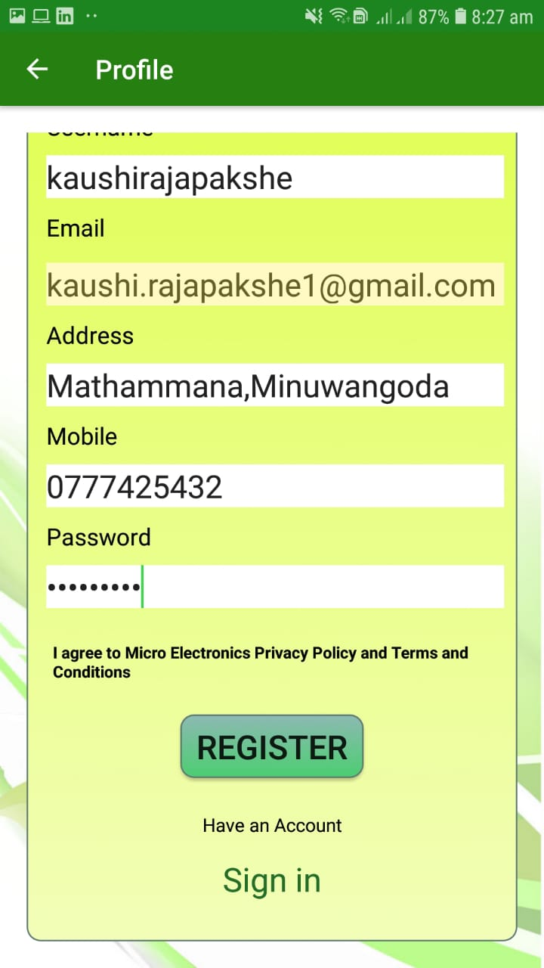
Comparison cont.
IT16178700
Easily recognizable input fields.
Identifiable labels
No app freezes

Slide 9
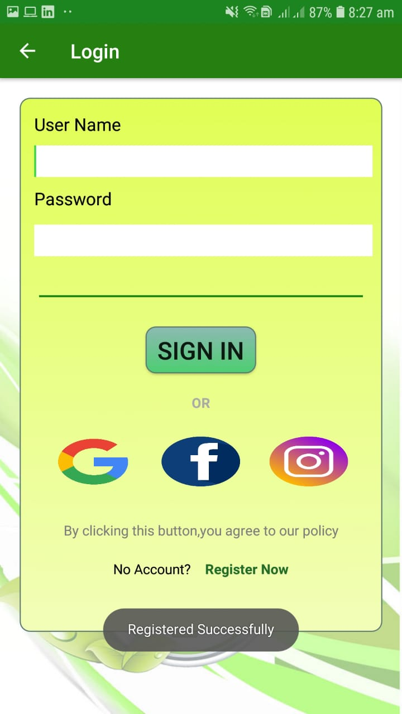
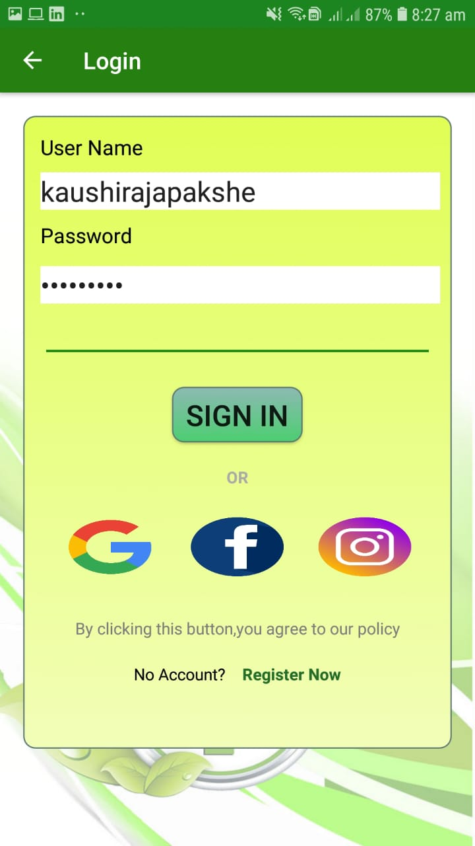
Usability Sign in Application
IT16178700
Showing logged user in navigation
Validation user fields.
Easily usable search field

Slide 10
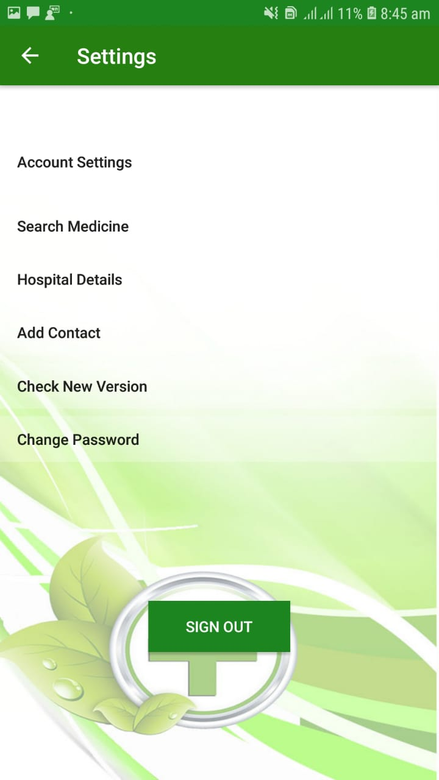
Settings functionality
IT16178700
User common settings fields.
Workable.
More secure application.
Easily get new version in application click via check new version.

Slide 11
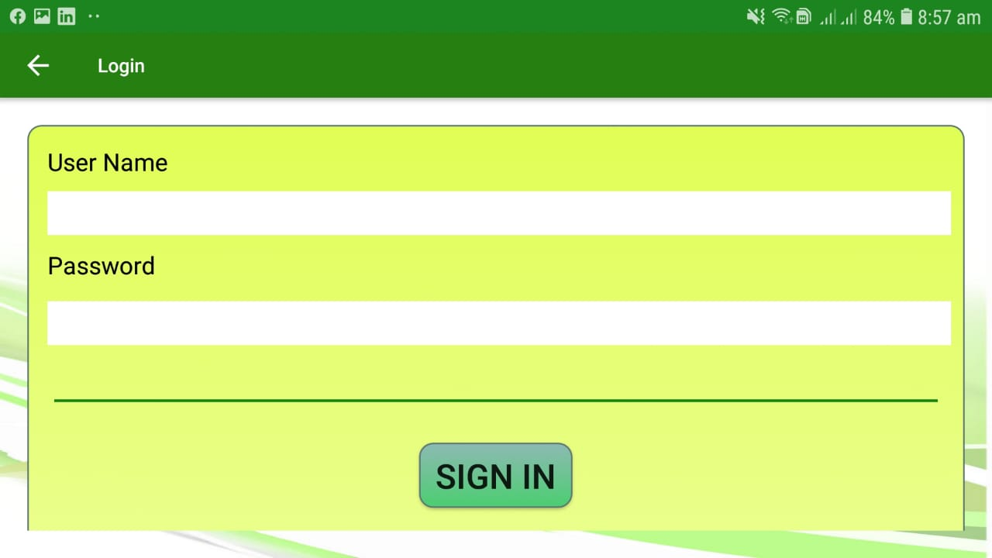
Usability & Responsiveness.
IT16178700
Responsive buttons.
Responsive lists.

Slide 12
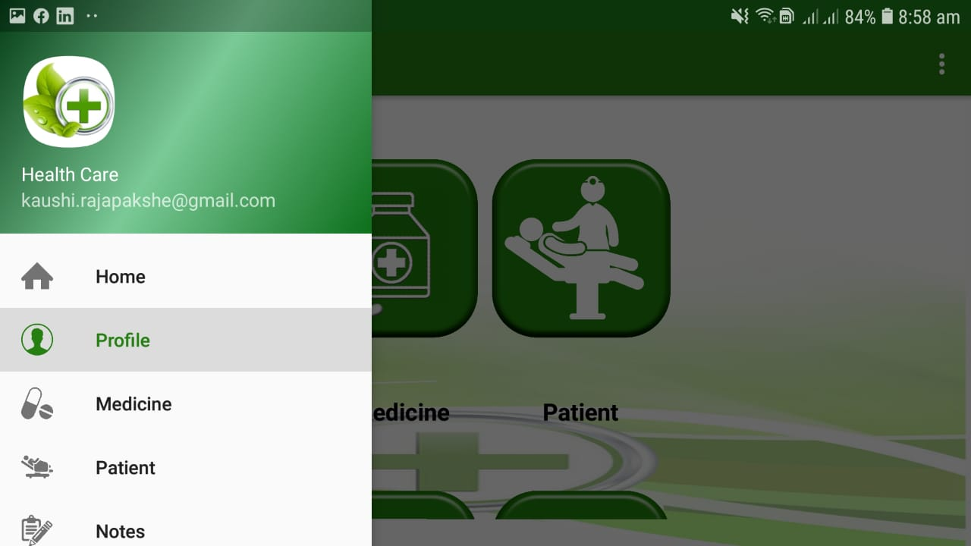
Usability & Responsiveness cont.
IT16178700
Responsive interfaces

Slide 13
Benefits to the user
IT16178700
Quicker way to manage Profile.
No app freezes.
Any screen resolution compatible (responsive design).
Faster UI design compared to similar apps.
Comfortable to eyes in the long term usage.
User understandable icons.

Slide 14

Medicine Function
IT17056212

Slide 15
Main Functions
IT17056212
Add Medicine.
Update Medicine.
Delete Medicine.
View Medicines as a list.
Search through Medicine list easily.

Slide 16
Superior UI/UX Design
IT17056212
Interfaces with attractive and user friendly colors.
Attractive overall design.
Fast navigation.
More accurate field validations.

Slide 17
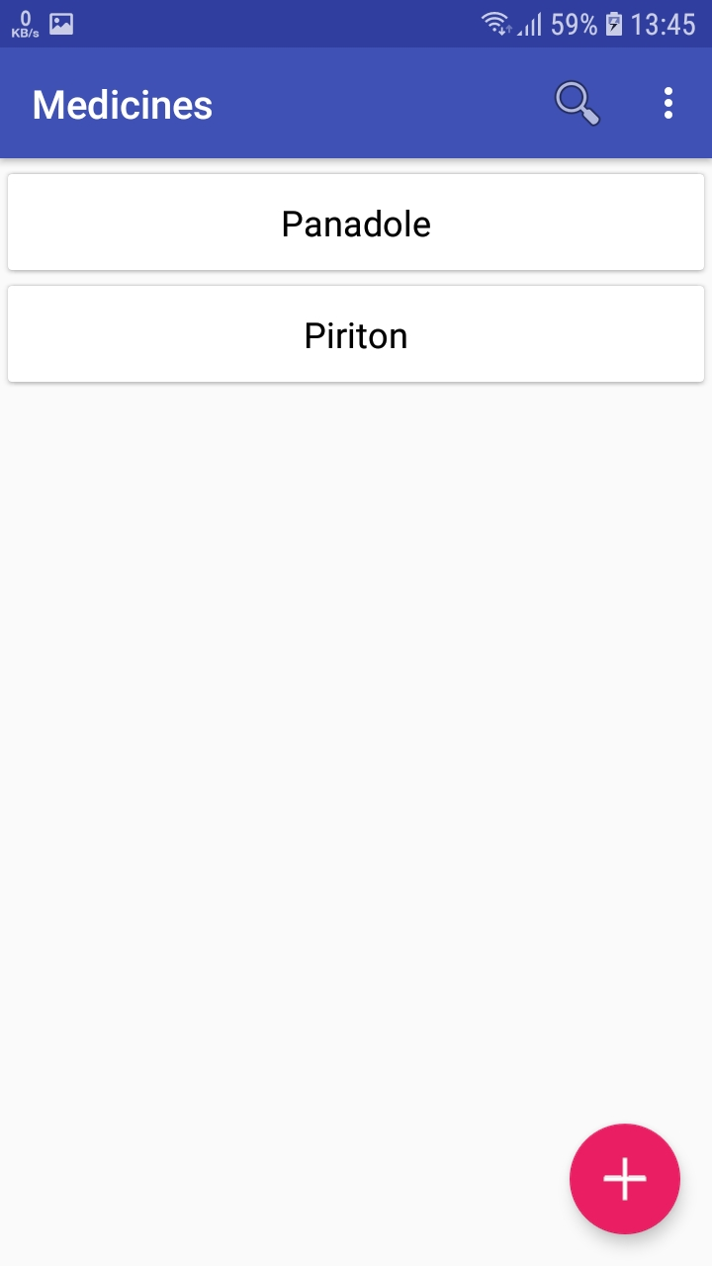
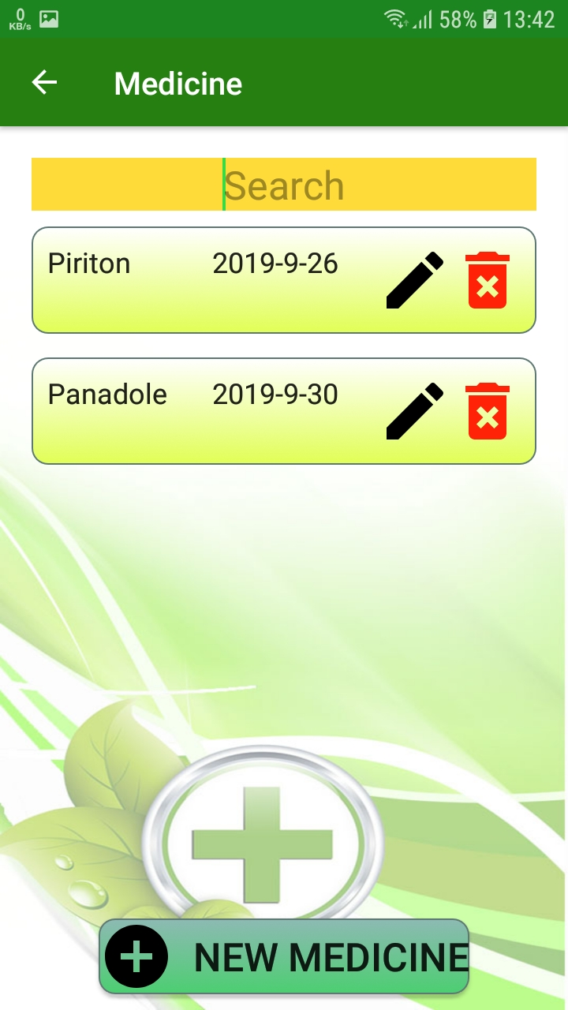
Comparison to other app
IT17056212
Easily usable search field.
More details on the list.
Add/Edit/Delete icons are easily identifiable.

Slide 18
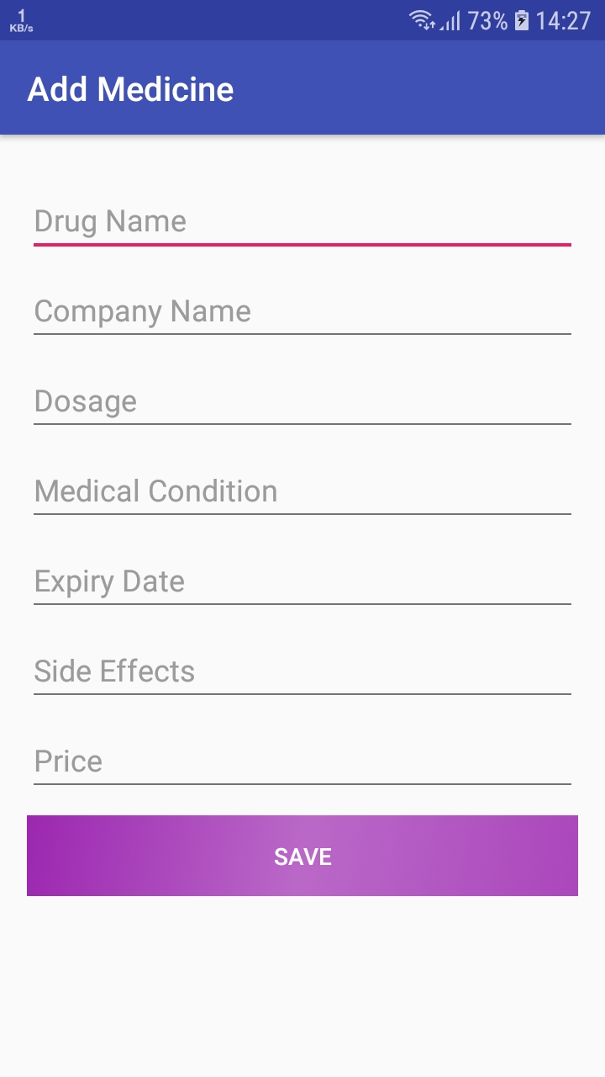
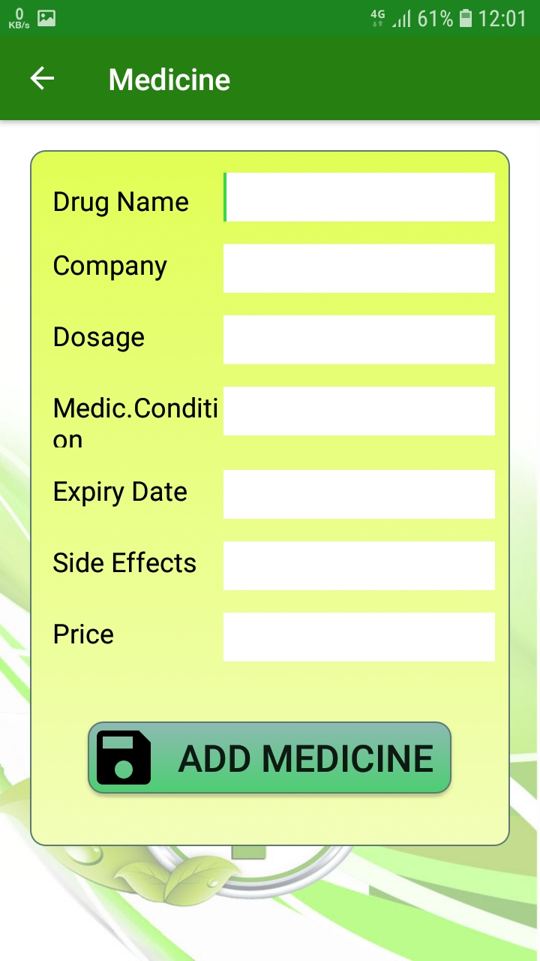
Comparison cont.
IT17056212
Easily recognizable input fields.
Identifiable labels

Slide 19
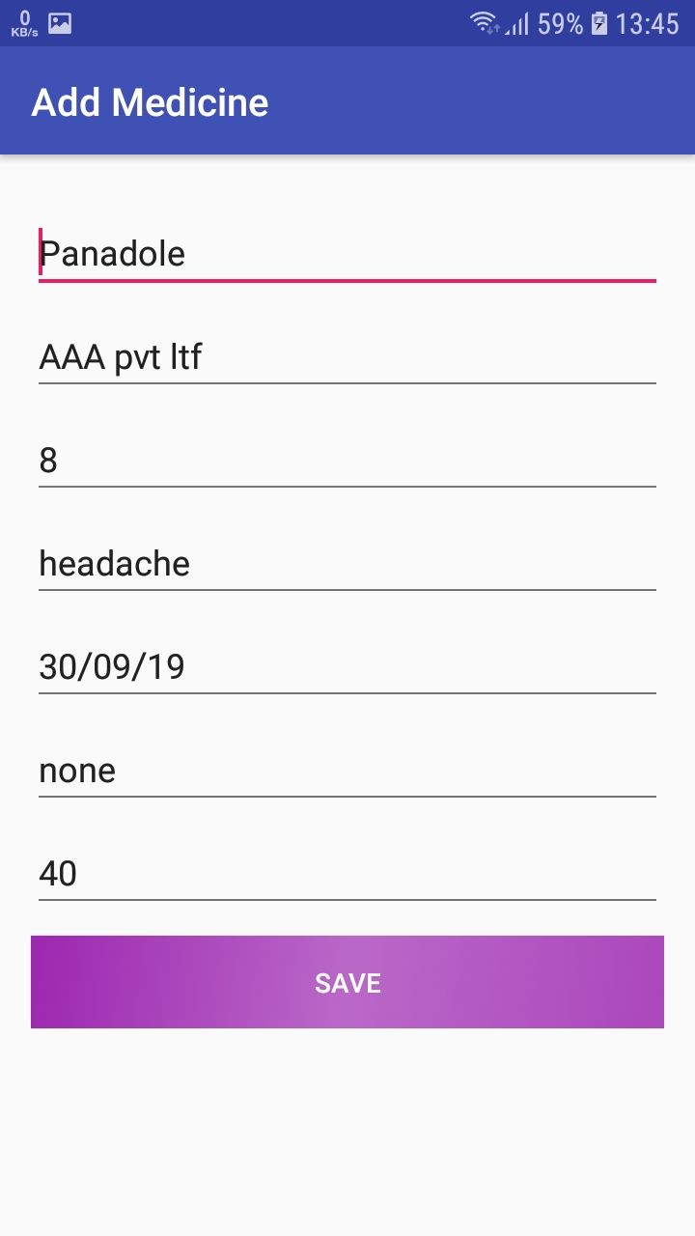
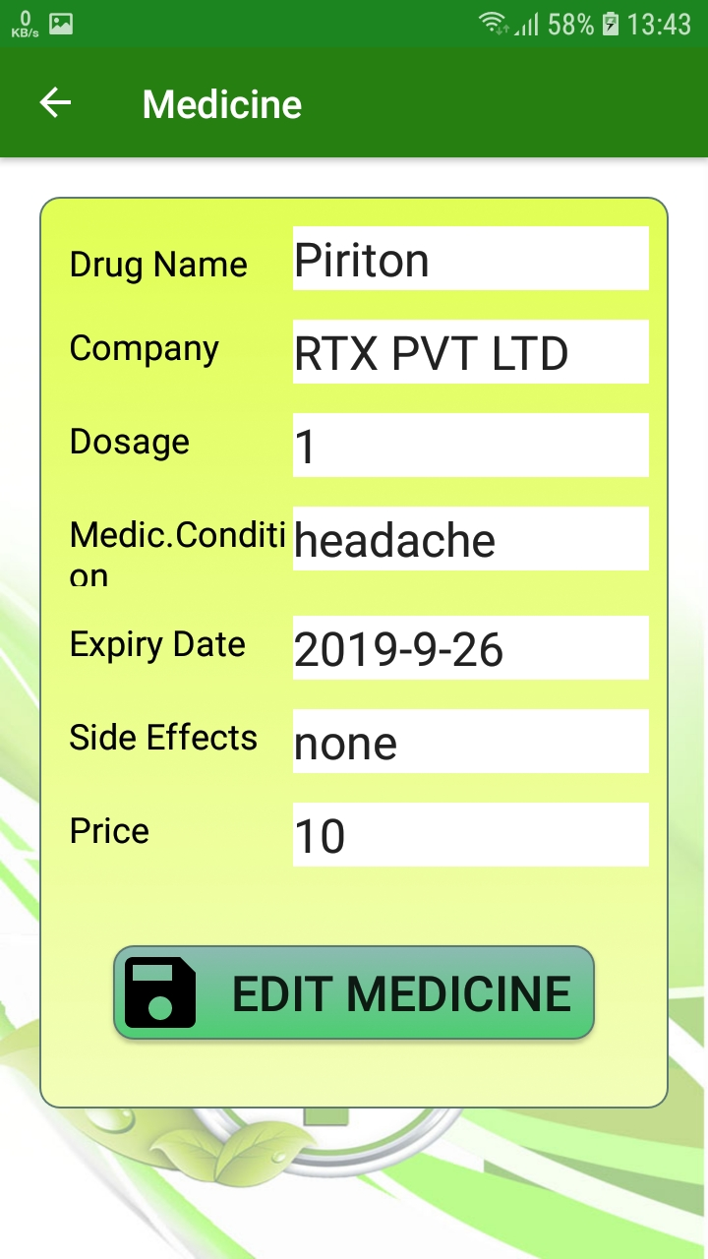
Comparison cont.
IT17056212
Easily recognizable input fields.
Identifiable labels

Slide 20
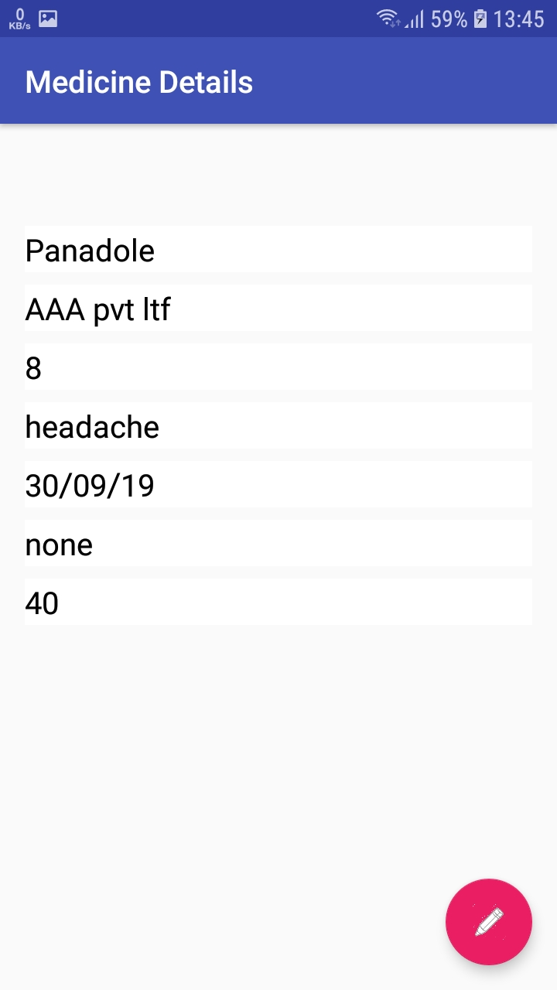
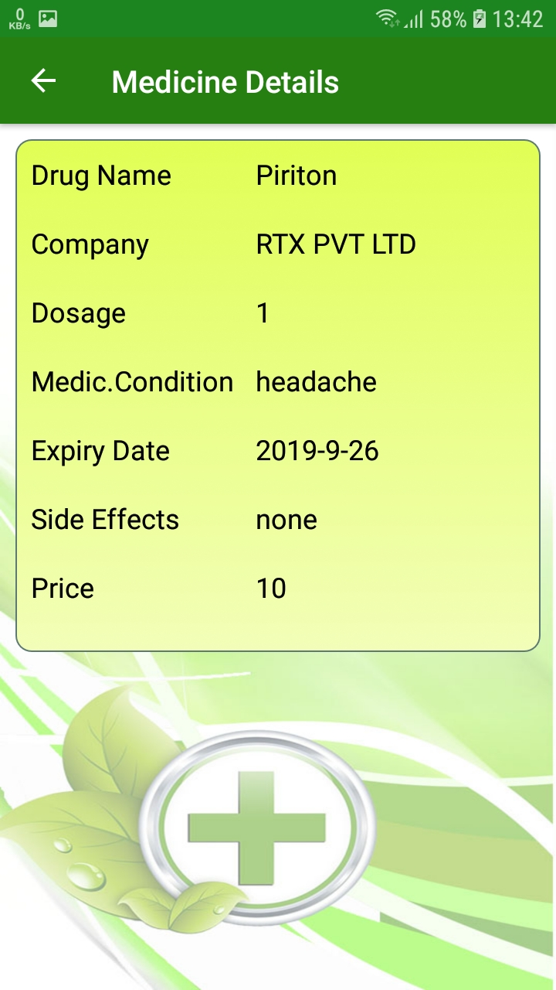
Comparison cont.
IT17056212
More clear view for details.
Identifiable labels

Slide 21
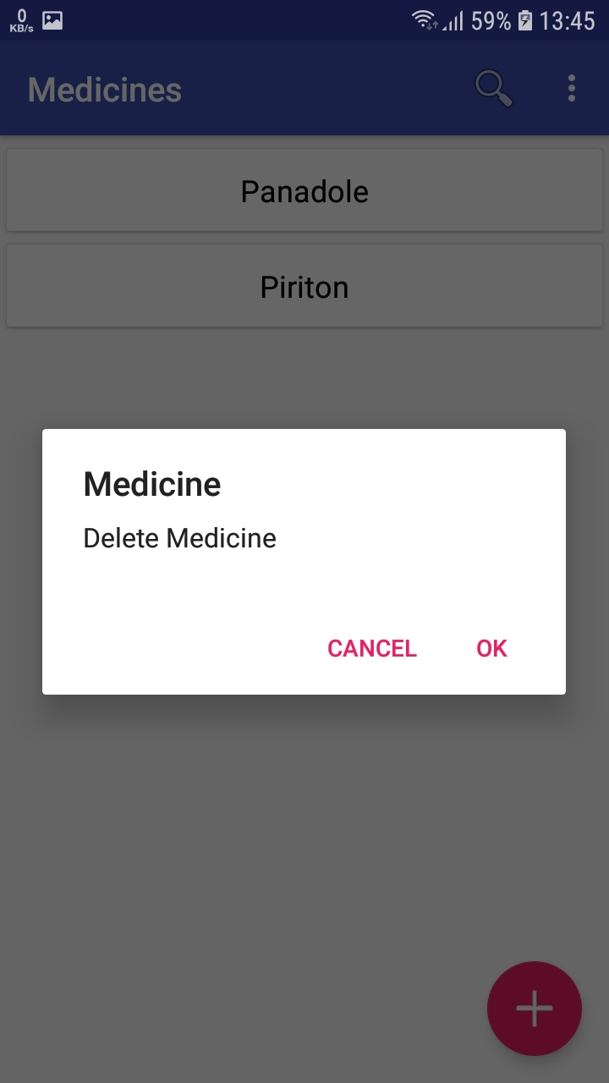
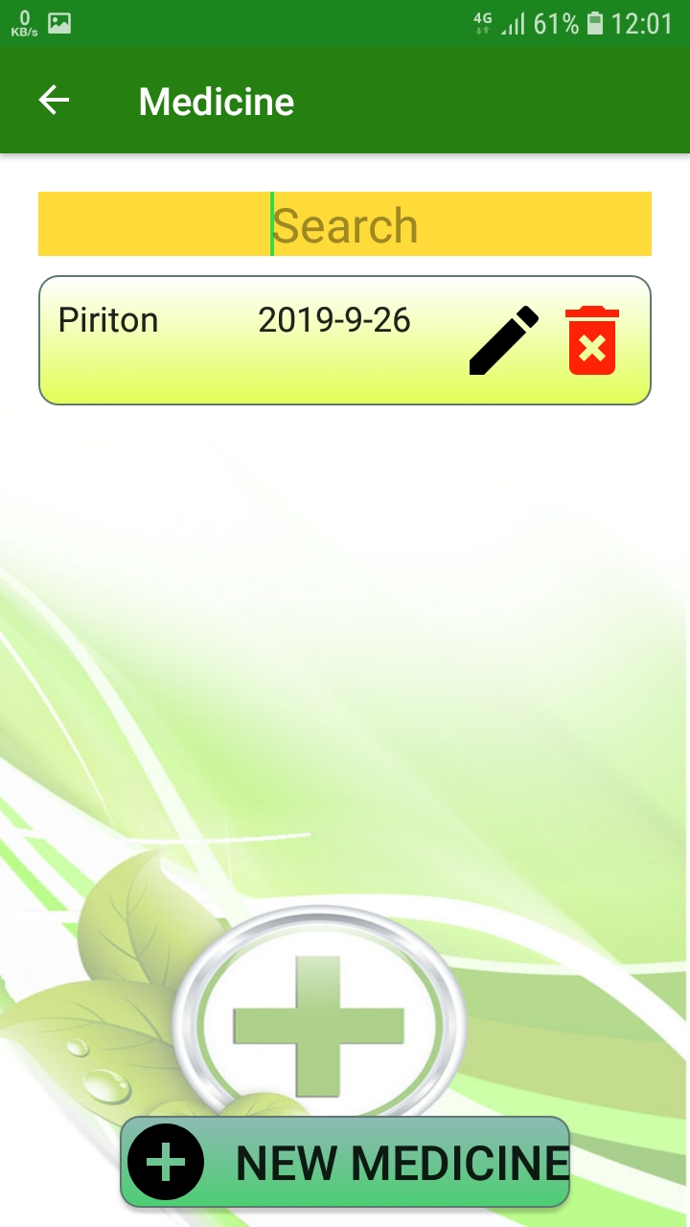
Comparison cont.
IT17056212
Identifiable delete option instead of long tap delete.

Slide 22
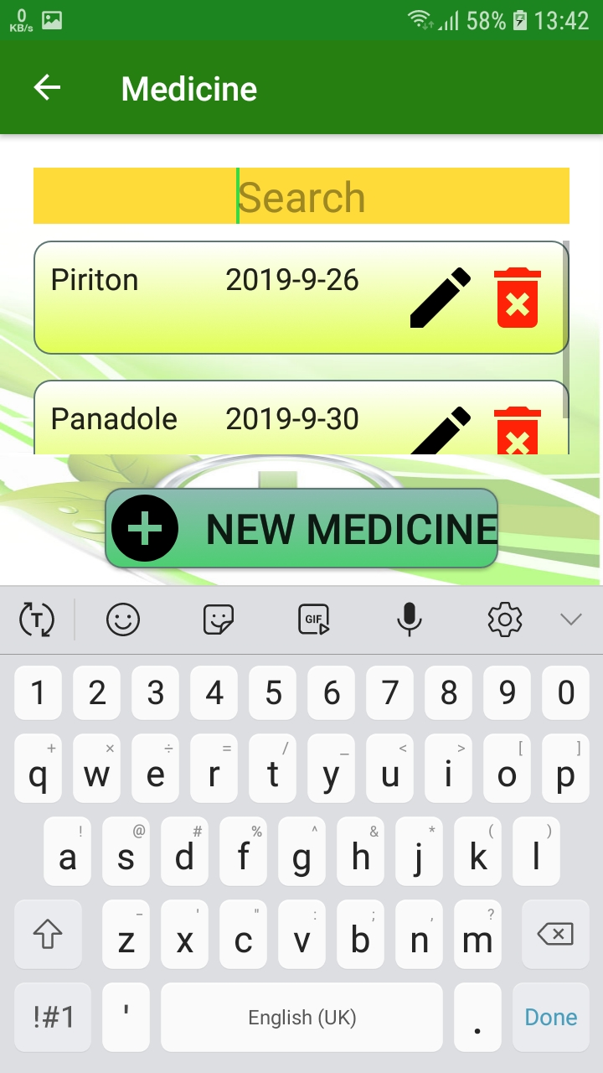
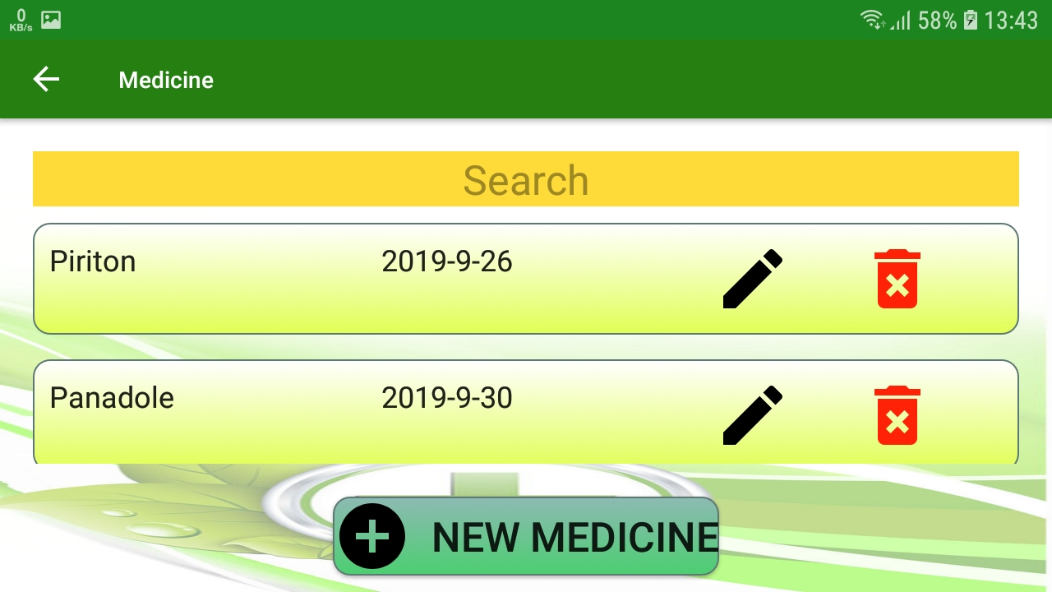
Usability & Responsiveness.
IT17056212
Responsive buttons.
Responsive lists.

Slide 23
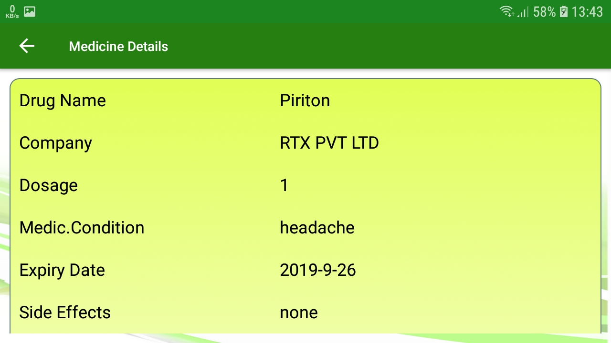
Usability & Responsiveness cont.
IT17056212
Responsive interfaces

Slide 24
Benefits to the user
IT17056212
Quicker way to manage medicines.
No app freezes.
Any screen resolution compatible (responsive design).
Faster UI design compared to similar apps.
Comfortable to eyes in the long term usage.

Slide 25

Patient Function
IT17152938

Slide 26
Main Functions
IT17152938
Add Patient.
Update Patient Details.
Update Patient health situation when visited
Delete Patient.
View Patients as a list.
Search through Patients list easily.

Slide 27
Superior UI/UX Design
IT17152938
Interfaces with attractive and user friendly colors.
Attractive overall design.
Fast navigation.
Easily understandable ui design
More accurate field validations.

Slide 28
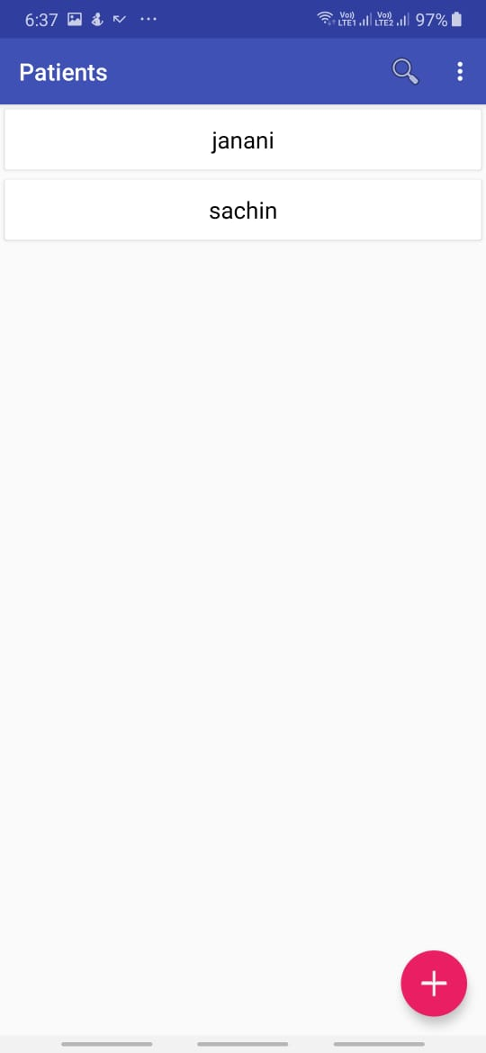
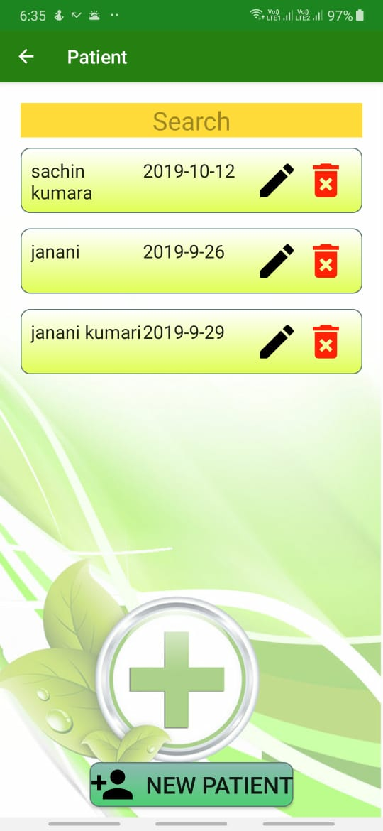
Comparison to other app
IT17152938
Easily usable real time search field.
More details on the list.
Add/Edit/Delete icons are easily identifiable.

Slide 29
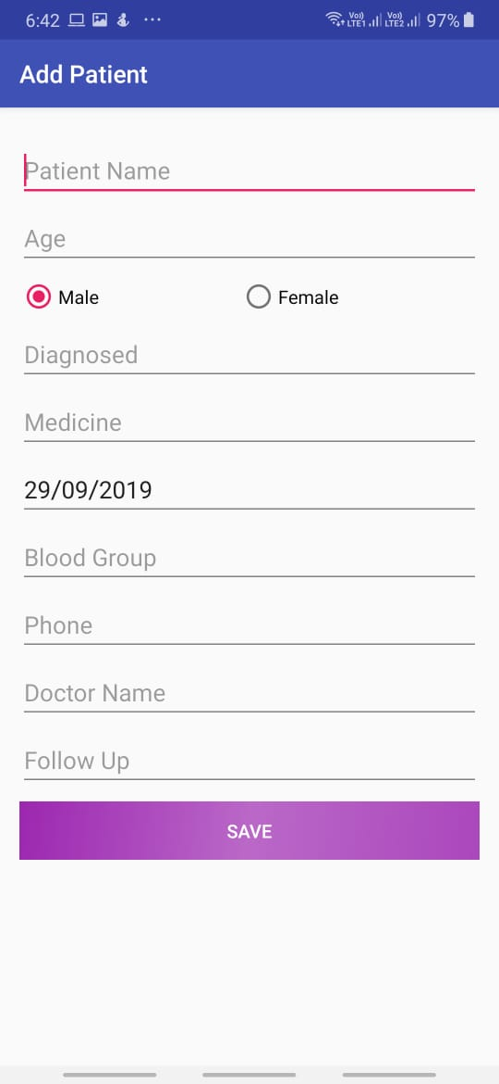
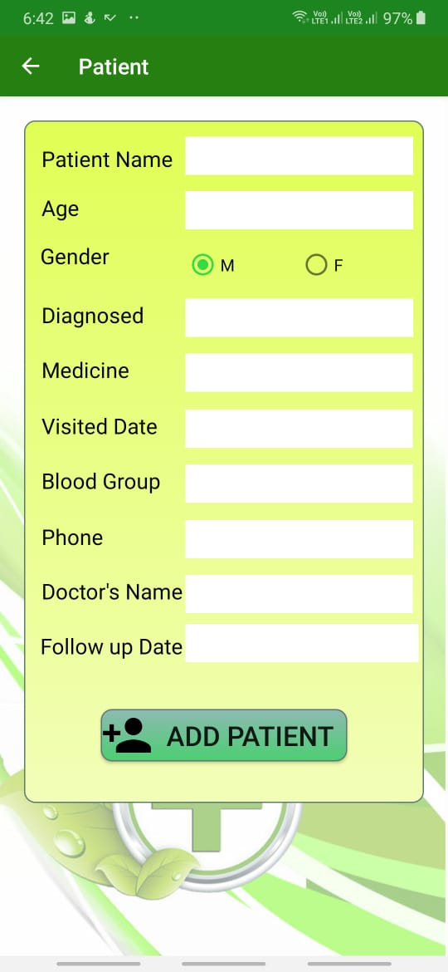
Comparison cont.
IT17152938
Easily recognizable input fields.
Identifiable labels
All fields are validated
Easily recognizable input fields.
Identifiable labels

Slide 30
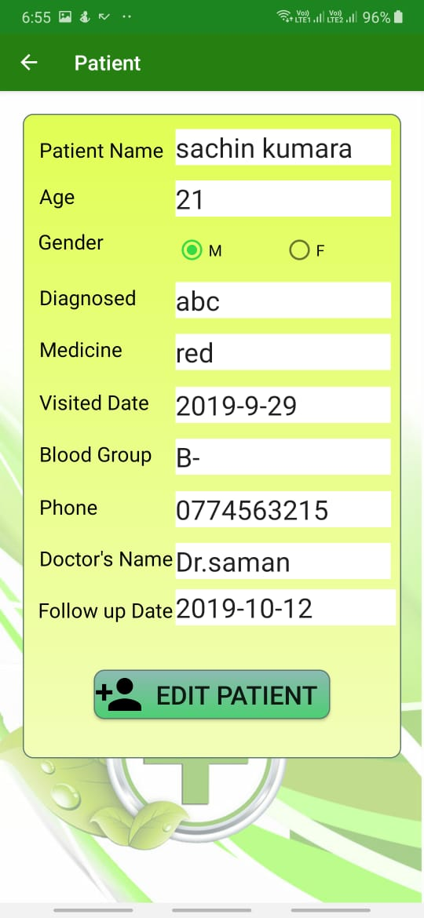
Comparison cont.
IT17152938
Per loaded field for Edit patient
Easily identify edit page
Identifiable labels

Slide 31
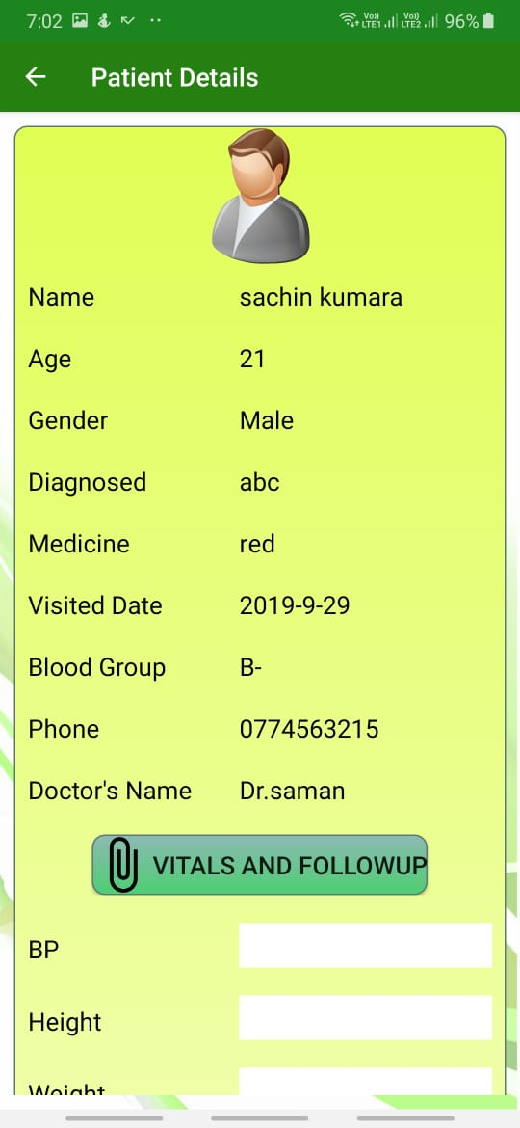
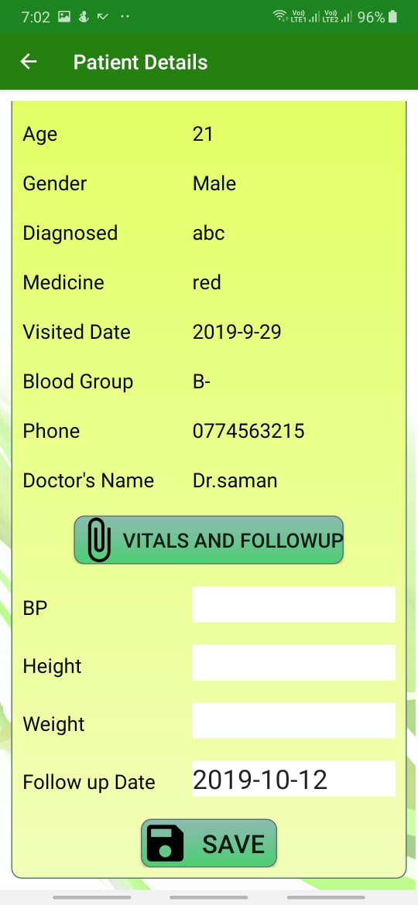
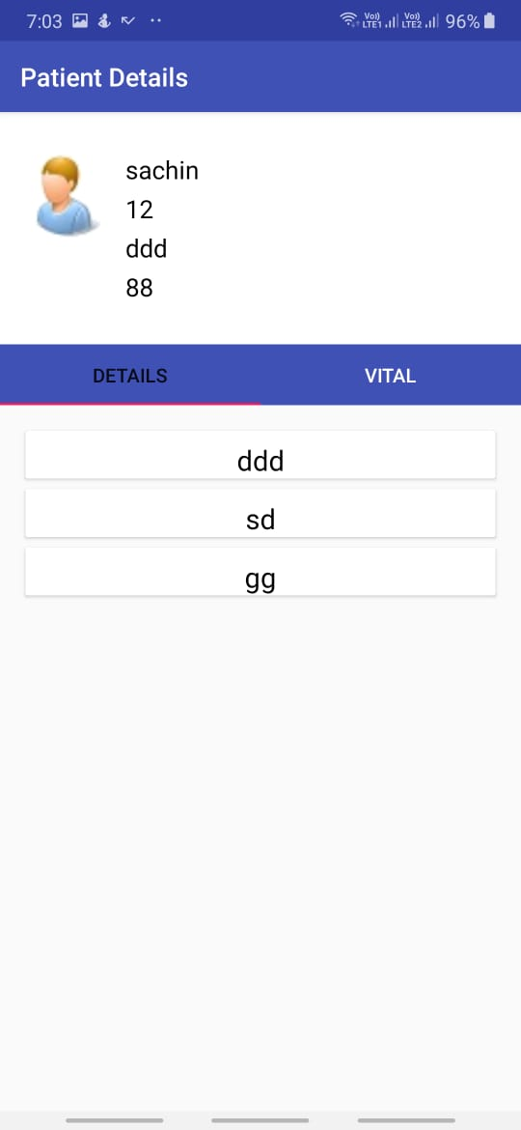
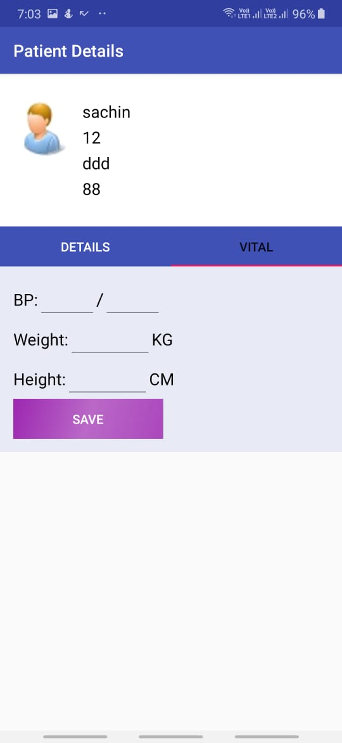
Comparison cont.
IT17152938
More clear view for details.
Identifiable labels

Slide 32
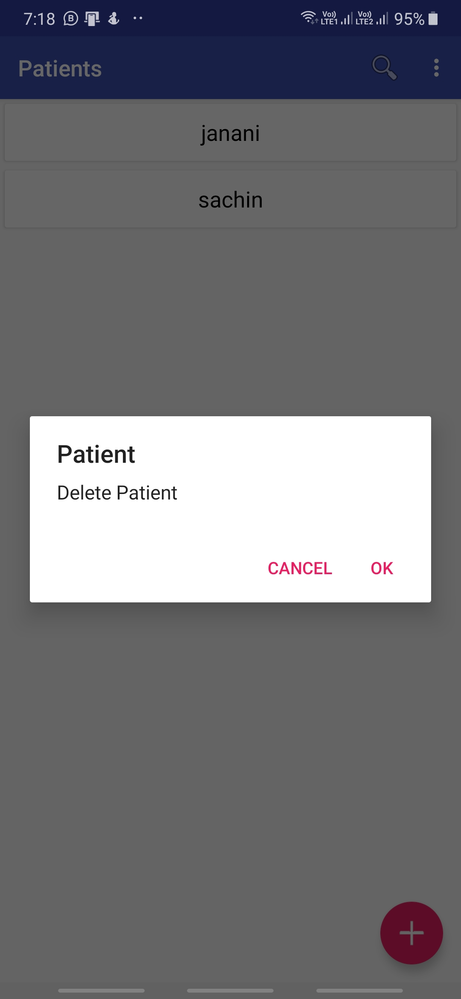
Comparison cont.
IT17152938
Identifiable delete option instead of long tap delete.

Slide 33
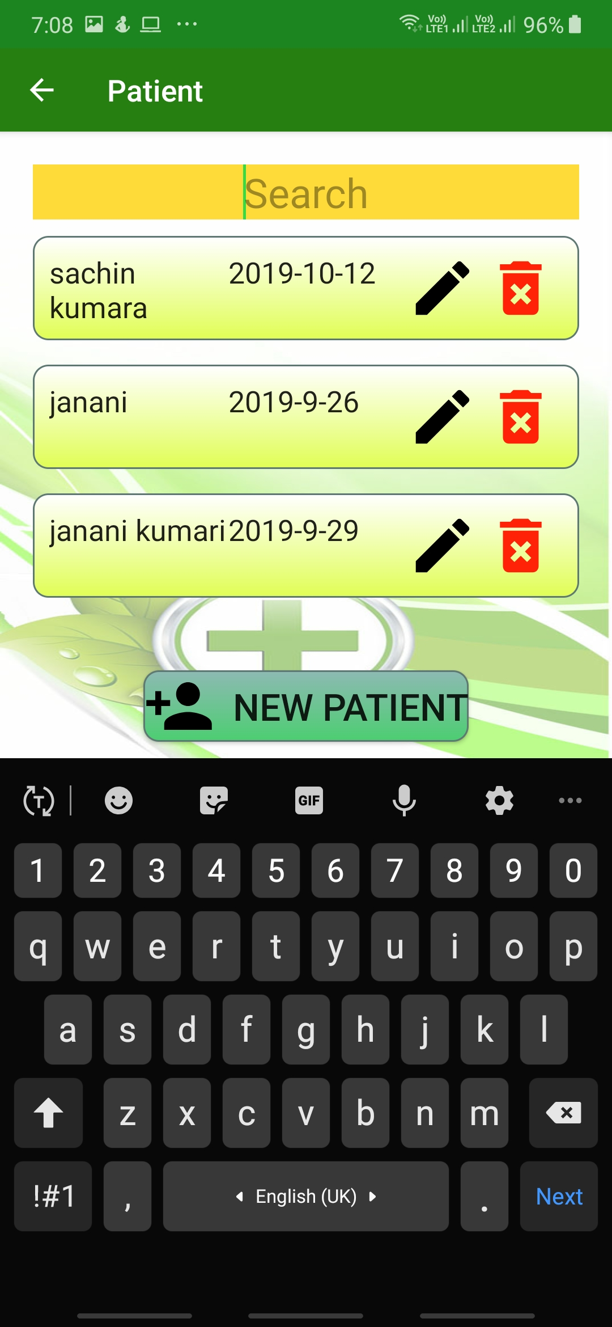
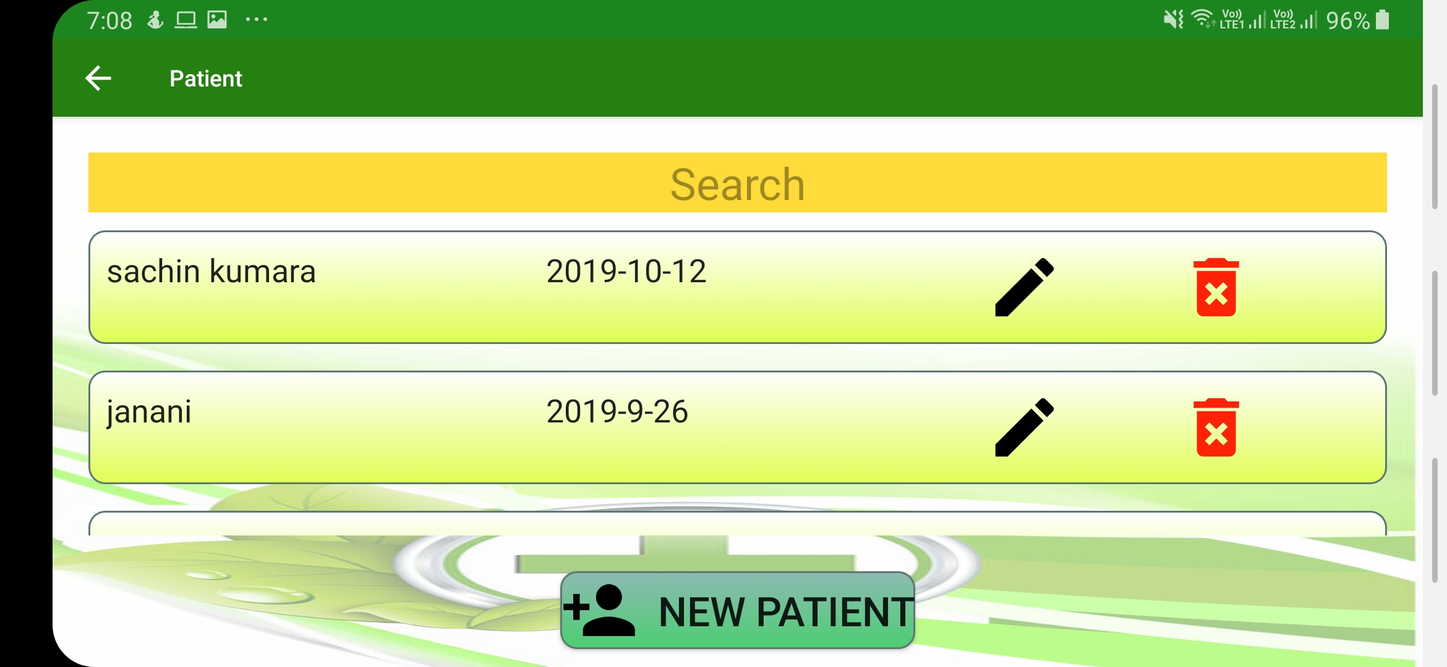
Usability & Responsiveness cont.
IT17152938
Responsive interfaces

Slide 34
Benefits to the user
IT17152938
Quicker way to manage Patients.
No app freezes.
Any screen resolution compatible (responsive design).
Faster UI design compared to similar apps.
Comfortable to eyes in the long term usage.

Slide 35

NOTE FUNCTIONALITY
IT16178700

Slide 36
Main Functions
IT16178700
Add NOTE.
Update NOTE.
Delete NOTE.
View NOTE as a list.
Search through NOTE list easily.

Slide 37
Superior UI/UX Design
IT16178700
Interfaces with attractive and user friendly colors.
Attractive overall design.
Fast navigation.
More accurate field validations.

Slide 38
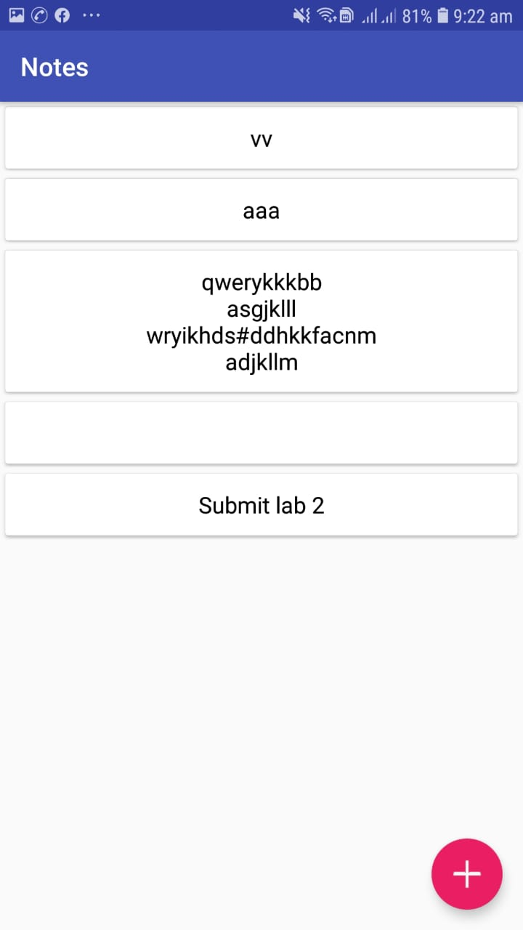
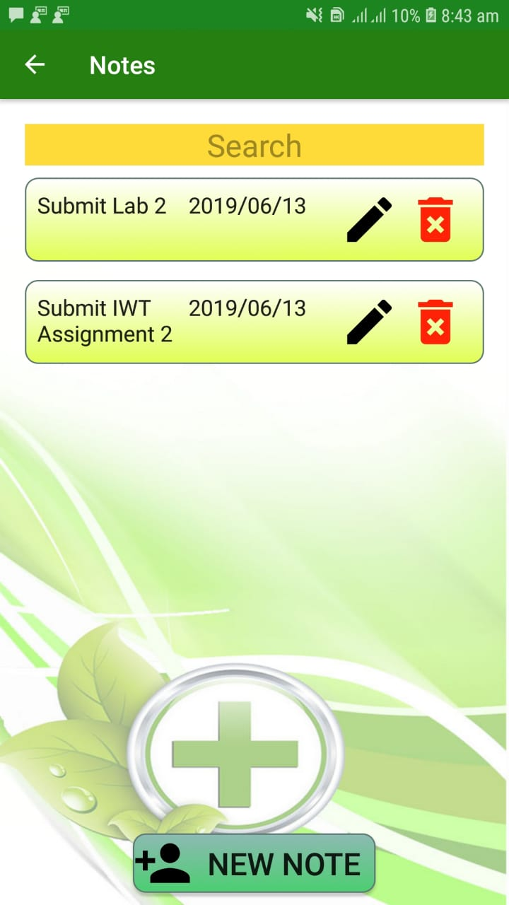
Comparison to other app
IT16178700
Easily usable search field.
More details on the list.
Add/Edit/Delete icons are easily identifiable.

Slide 39
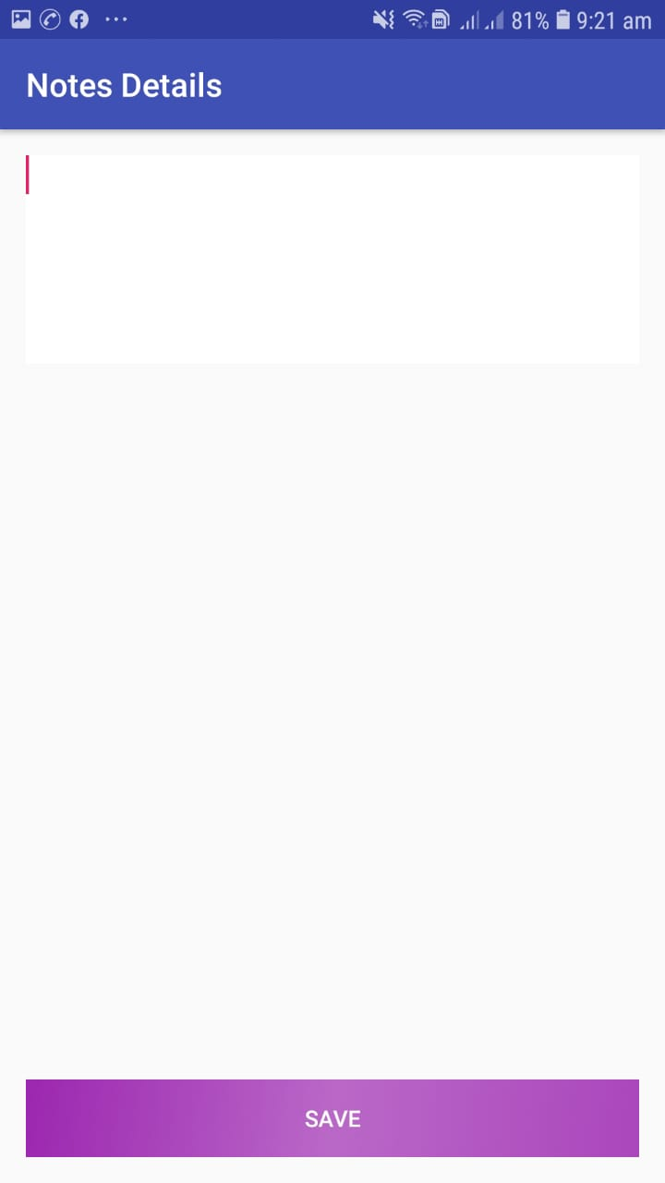
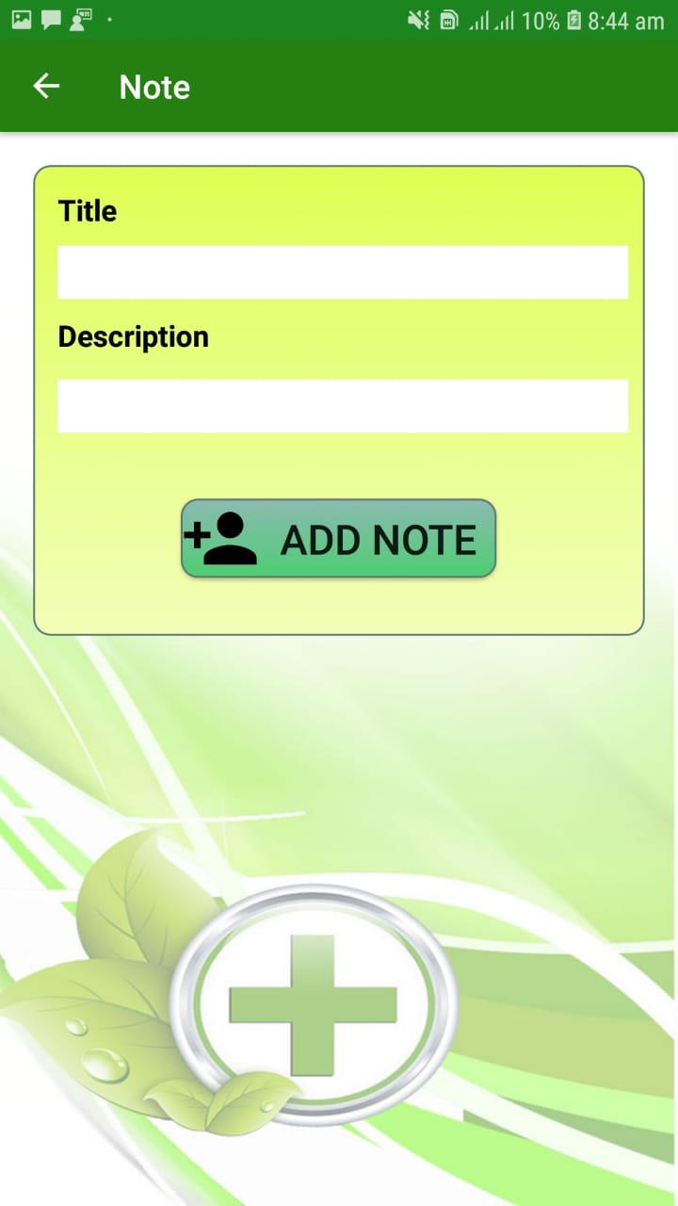
Comparison cont.
IT16178700
Easily recognizable input fields.
Identifiable labels

Slide 40
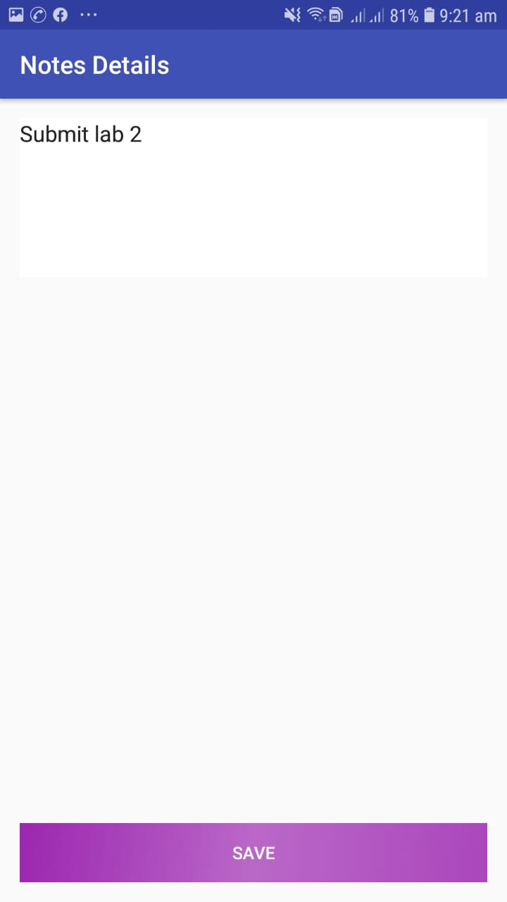
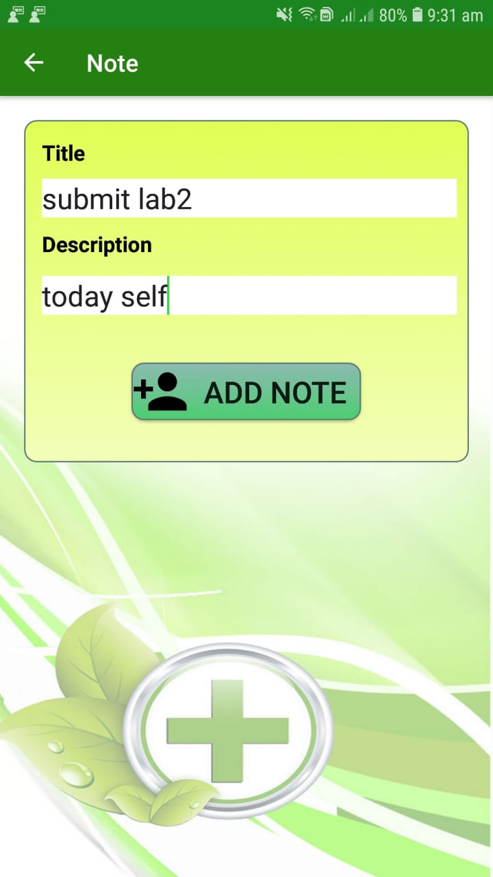
Comparison cont.
IT16178700
Easily recognizable input fields.
Identifiable labels

Slide 41
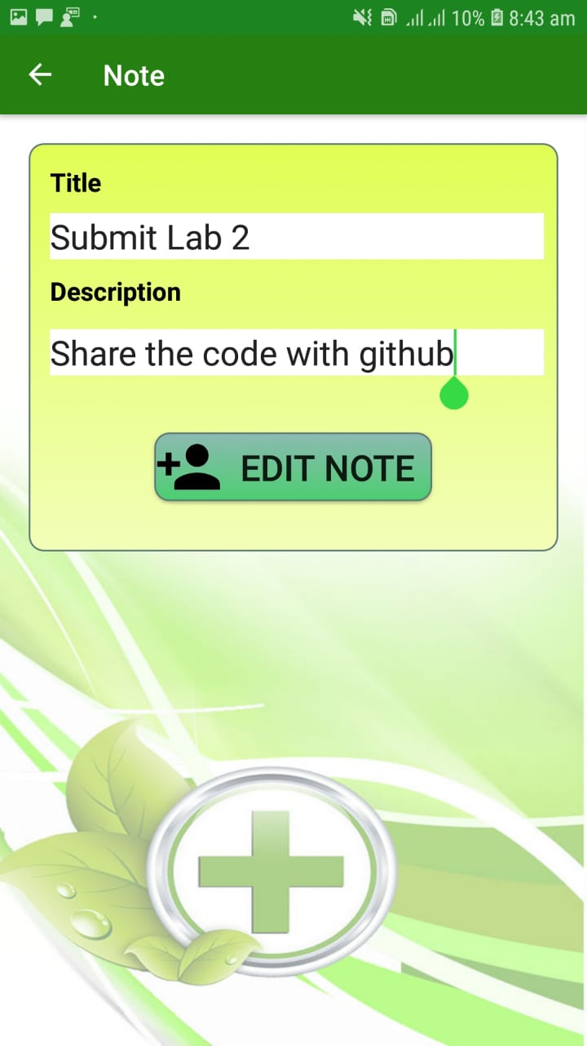
IT16178700
Comparison cont.
Easily recognizable input fields.
Identifiable labels

Slide 42
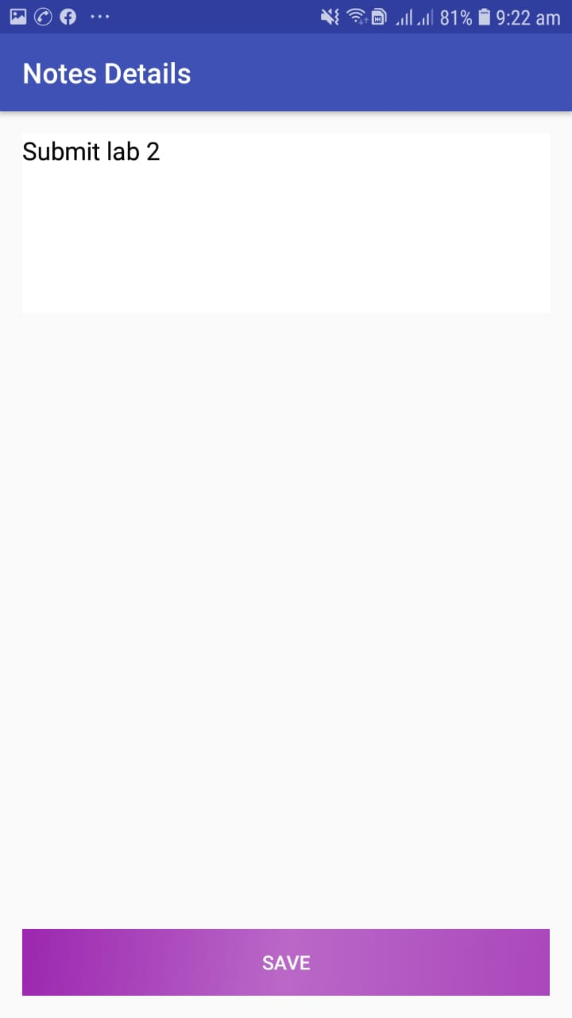
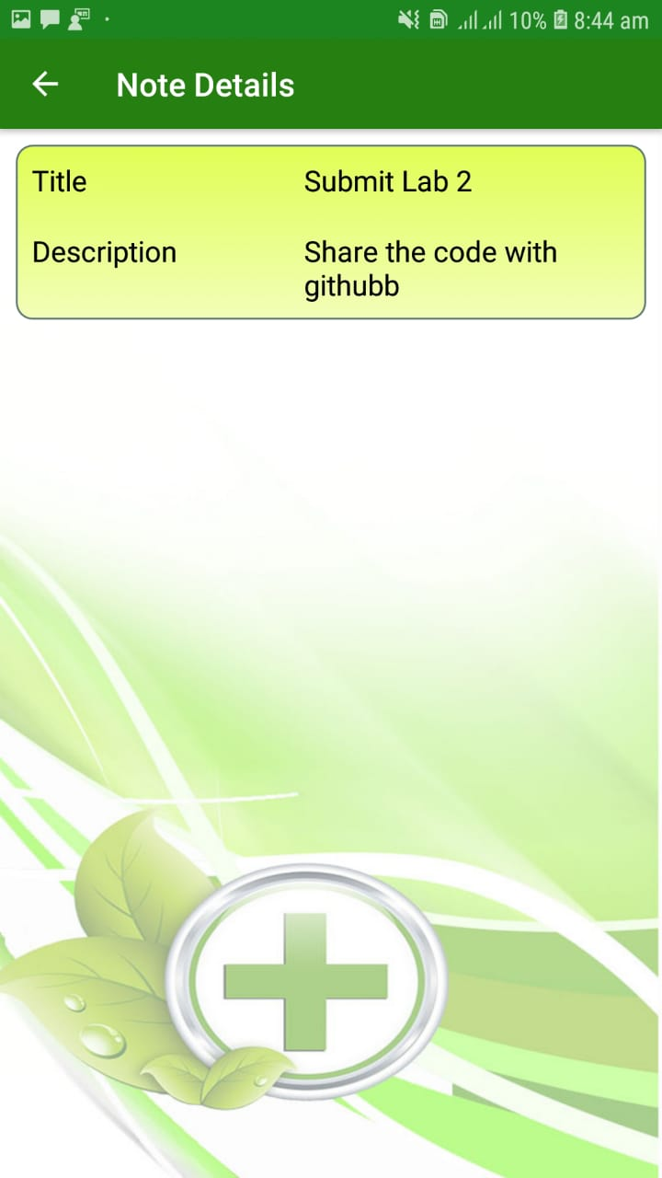
Comparison cont.
IT16178700
More clear view for details.
Identifiable labels

Slide 43
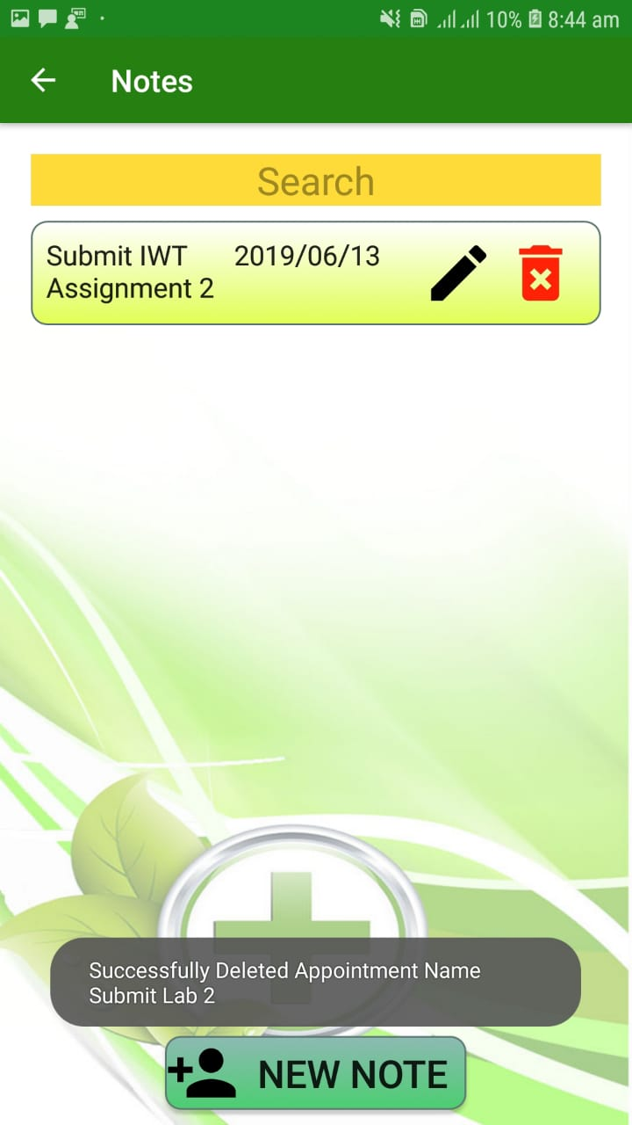
Comparison cont.
IT16178700
Identifiable delete option instead of long tap delete.

Slide 44
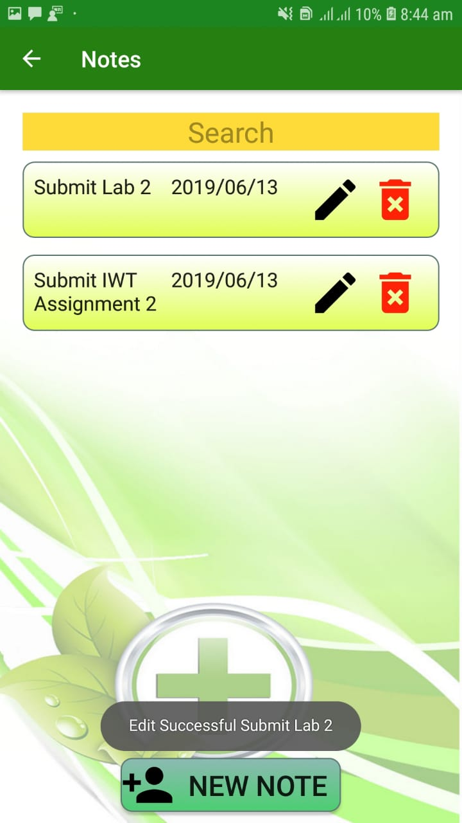
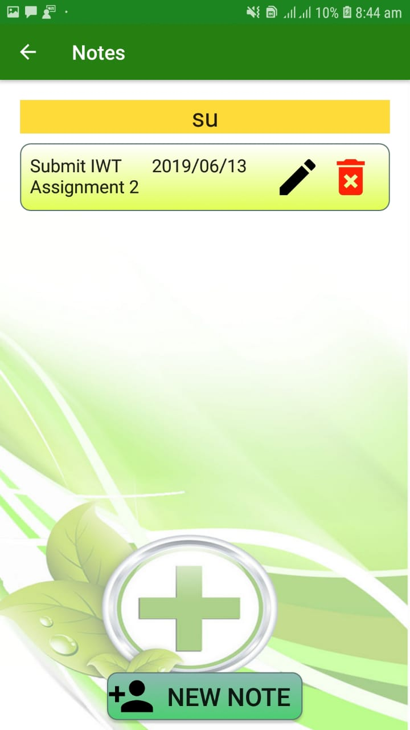

Usability OF Note functionality
IT16178700
User can easily search their notes.
User can easily view their work using toast messages
Validate the fields.

Slide 45

Usability & Responsiveness.
IT16178700
Responsive buttons.
Responsive lists.

Slide 46

Usability & Responsiveness cont.
IT16178700
Responsive interfaces

Slide 47
Benefits to the user
IT16178700
Quicker way to manage Notes.
No app freezes.
Any screen resolution compatible (responsive design).
Faster UI design compared to similar apps.
Comfortable to eyes in the long term usage.

Slide 48
Appointments Function
IT17018760
Doctors can easily find their appointments from here and they can easily manage their time from here.

Slide 49
INTRODUCTION
IT17018760
The use of mobile devices by health care professionals has transformed many aspects of clinical practice.
So doctors can easily record their patient appointments and view it.
So that he don’t want to memorise all the appointments because all are in the mobile device through the app.
So that doctors or physicians can save their time and effort.

Slide 50



Comparison to other app
IT17018760
In the earlier application there is only this calendar page.
In that app can add appointments as a mobile phone event . It is not practical and can view the added details.
Calendar View
Add Event Button
Event Manager in mobile

Slide 51

This appointment function has 3 main categories.
IT17018760
Add Appointment
View Appointments
My Calendar

Slide 52
Superior UI/UX Design
IT17018760
User can easily find the appointments which they added.
Easily navigate through these interfaces.
User can easily find his available dates from the calendar.

Slide 53



Add Appointments
IT17018760
User can able to add appointments through this category.
User need to fill all the appointment details otherwise it notifies errors.
Fill all the fields in appointment
Shows the message when appointment is added.

Slide 54


View Appointments
IT17018760
User can able to view all the appointments through this category.
User can type appointment name in search bar and can search the relevant appointment
Views all the appointments in the system
Views typed appointment in the search bar.

Slide 55


View Appointment Cont.
IT17018760
Edit Appointment
User can edit their all the appointment details
User can able to edit appointment details.
Displays the message in the bottom when edit is succeed.

Slide 56

View Appointment Cont.
IT17018760
Delete Appointment
User can delete their appointment details
When tap bin icon , user can delete appointment from the system. It can’t undo.

Slide 57

My Calendar
IT17018760
In this interface user can see the calendar in past , present and future.
In this interface also can navigate to add appointment after seeing user’s available date.

